Slide 1
2024 – 2025 Budget

Slide 2
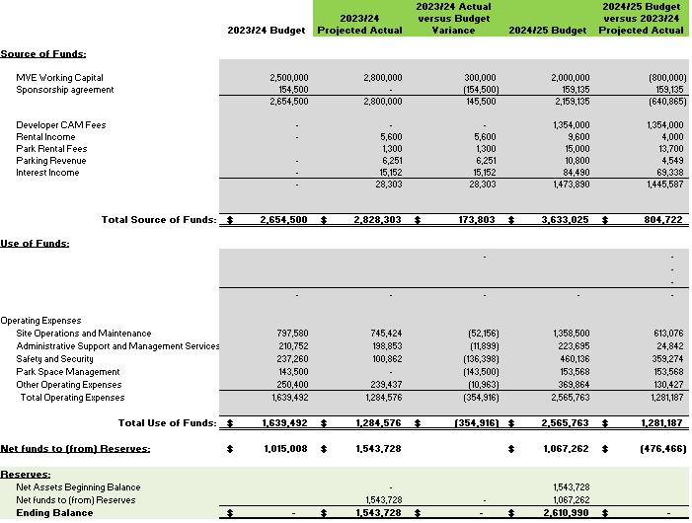
Budget Summary
Notes:
KEY FINANCIAL POINTS FOR AZTEC SHOPS OVERALL BUDGET

